Slide 1
Software Testing
Testing

Slide 2
Background
Main objectives of a project: High Quality & High Productivity (Q&P)
Quality has many dimensions
  reliability, maintainability, interoperability etc.
Reliability is perhaps the most important
Reliability: The chances of software failing
More defects => more chances of failure => lesser reliability
Hence Q goal: Have as few defects as possible in the delivered software
Testing

Slide 3
Faults & Failure
Failure: A software failure occurs if the behavior of the s/w is different from expected/specified.
Fault: cause of software failure
Fault = bug = defect
Failure implies presence of defects
A defect has the potential to cause failure.
Definition of a defect is environment, project specific
Testing

Slide 4
Role of Testing
Reviews are human processes - can not catch all defects
Hence there will be requirement defects, design defects and coding defects in code
These defects have to be identified by testing
Therefore testing plays a critical role in ensuring quality.
All defects remaining from before as well as new ones introduced have to be identified by testing.
Testing

Slide 5
Detecting defects in Testing
During testing, a program is executed with a set of test cases
Failure during testing => defects are present
No failure => confidence grows, but can not say “defects are absent”
Defects detected through failures
To detect defects, must cause failures during testing
Testing

Slide 6
Test Oracle
To check if a failure has occurred when executed with a test case, we need to know the correct behavior
I.e. need a test oracle, which is often a human
Human oracle makes each test case expensive as someone has to check the correctness of its output
Testing

Slide 7
Role of Test cases
Ideally would like the following for test cases
  No failure implies “no defects” or “high quality”
  If defects present, then some test case causes a failure
Psychology of testing is important
  should be to ‘reveal’ defects(not to show that it works!)
  test cases must be “destructive
Role of test cases is clearly very critical
Only if test cases are “good”, the confidence increases after testing
Testing

Slide 8
Test case design
During test planning, have to design a set of test cases that will detect defects present
Some criteria needed to guide test case selection
Two approaches to design test cases
  functional or black box
  structural or white box
Both are complimentary; we discuss a few approaches/criteria for both
Testing

Slide 9
Black Box testing
Software tested to be treated as a block box
Specification for the black box is given
The expected behavior of the system is used to design test cases
i.e test cases are determined solely from specification.
Internal structure of code not used for test case design
Testing

Slide 10
Black box Testing…
Premise: Expected behavior is specified.
Hence just test for specified expected behavior
How it is implemented is not an issue.
For modules,specification produced in design specify expected behavior
For system testing, SRS specifies expected behavior
Testing

Slide 11
Black Box Testing…
Most thorough functional testing - exhaustive testing
  Software is designed to work for an input space
  Test the software with all elements in the input space
Infeasible - too high a cost
Need better method for selecting test cases
Different approaches have been proposed
Testing

Slide 12
Equivalence Class partitioning
Divide the input space into equivalent classes
If the software works for a test case from a class then it is likely to work for all
Can reduce the set of test cases if such equivalent classes can be identified
Getting ideal equivalent classes is impossible
Approximate it by identifying classes for which different behavior is specified
Testing

Slide 13
Equivalence class partitioning…
Rationale: specification requires same behavior for elements in a class
Software likely to be constructed such that it either fails for all or for none.
E.g. if a function was not designed for negative numbers then it will fail for all the negative numbers
For robustness, should form equivalent classes for invalid inputs also
Testing

Slide 14
Equivalent class partitioning..
Every condition specified as input is an equivalent class
Define invalid equivalent classes also
E.g. range 0< value<Max specified
  one range is the valid class
  input < 0 is an invalid class
  input > max is an invalid class
Whenever that entire range may not be treated uniformly - split into classes
Testing

Slide 15
Equivalent class partitioning..
Should consider eq. classes in outputs also and then give test cases for different classes
E.g.: Compute rate of interest given loan amount, monthly installment, and number of months
  Equivalent classes in output: + rate, rate = 0 ,-ve rate
  Have test cases to get these outputs
Testing

Slide 16
Equivalence class…
Once eq classes selected for each of the inputs, test cases have to be selected
  Select each test case covering as many valid eq classes as possible
  Or, have a test case that covers at most one valid class for each input
  Plus a separate test case for each invalid class
Testing

Slide 17
Example
Consider a program that takes 2 inputs – a string s and an integer n
Program determines n most frequent characters
Tester believes that programmer may deal with diff types of chars separately
A set of valid and invalid equivalence classes is given
Testing

Slide 18
Example..
Input | Valid Eq Class | Invalid Eq class
S | 1: Contains numbers 2: Lower case letters 3: upper case letters 4: special chars 5: str len between 0-N(max) | 1: non-ascii char 2: str len > N
N | 6: Int in valid range | 3: Int out of range
Testing

Slide 19
Example…
Test cases (i.e. s , n) with first method
  s : str of len < N with lower case, upper case, numbers, and special chars, and n=5
  Plus test cases for each of the invalid eq classes
  Total test cases: 1+3= 4
With the second approach
  A separate str for each type of char (i.e. a str of numbers, one of lower case, …) + invalid cases
  Total test cases will be 5 + 2 = 7
Testing

Slide 20
Boundary value analysis
Programs often fail on special values
These values often lie on boundary of equivalence classes
Test cases that have boundary values have high yield
These are also called extreme cases
A BV test case is a set of input data that lies on the edge of an eq class of input/output
Testing

Slide 21
BVA...
For each equivalence class
  choose values on the edges of the class
  choose values just outside the edges
E.g. if 0 <= x <= 1.0
  0.0 , 1.0 are edges inside
  -0.1,1.1 are just outside
E.g. a bounded list - have a null list , a maximum value list
Consider outputs also and have test cases generate outputs on the boundary
Testing

Slide 22
BVA…
In BVA we determine the value of vars that should be used
If input is a defined range, then there are 6 boundary values plus 1 normal value (tot: 7)
If multiple inputs, how to combine them into test cases; two strategies possible
  Try all possible combination of BV of diff variables, with n vars this will have 7^{n} test cases!
  Select BV for one var; have other vars at normal values + 1 of all normal values
Testing

Slide 23
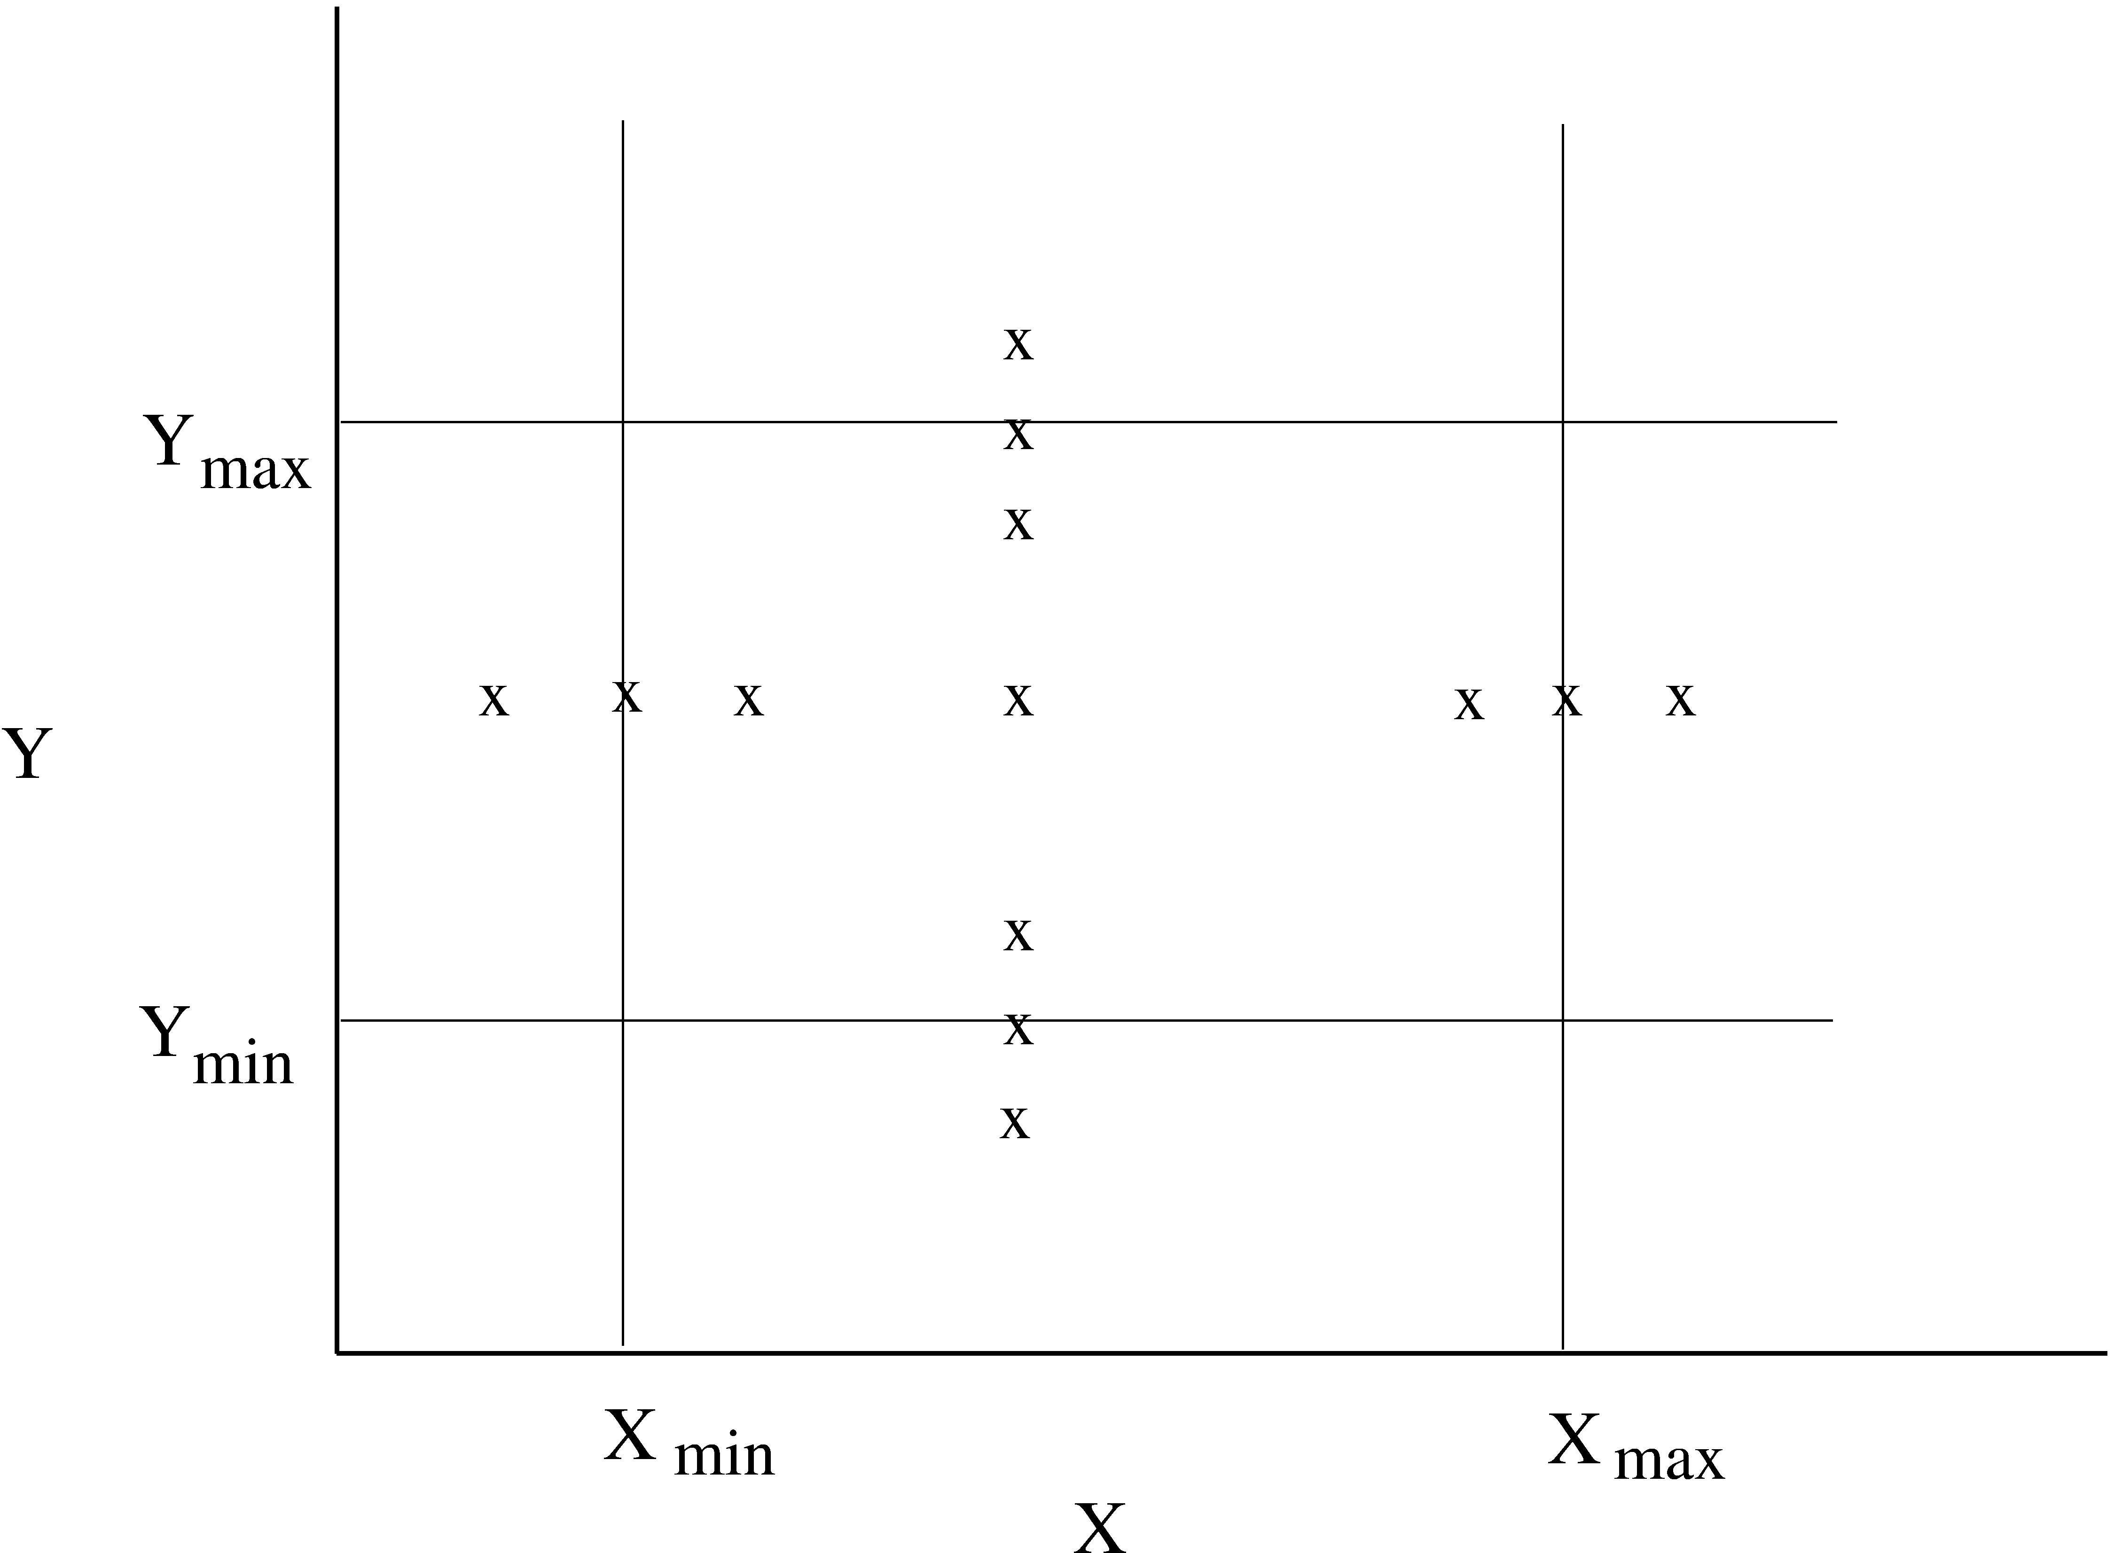
BVA.. (test cases for two vars – x and y)
Testing

Slide 24
Cause Effect graphing
Equivalence classes and boundary value analysis consider each input separately
To handle multiple inputs, different combinations of equivalent classes of inputs can be tried
Number of combinations can be large – if n diff input conditions such that each condition is valid/invalid, total: 2^{n}
Cause effect graphing helps in selecting combinations as input conditions
Testing

Slide 25
CE-graphing
Identify causes and effects in the system
  Cause: distinct input condition which can be true or false
  Effect: distinct output condition (T/F)
Identify which causes can produce which effects; can combine causes
Causes/effects are nodes in the graph and arcs are drawn to capture dependency; and/or are allowed
Testing

Slide 26
CE-graphing
From the CE graph, can make a decision table
  Lists combination of conditions that set different effects
  Together they check for various effects
Decision table can be used for forming the test cases
Testing

Slide 27
CE graphing: Example
A bank database which allows two commands
  Credit acc# amt
  Debit acc# amt
Requirements
  If credit and acc# valid, then credit
  If debit and acc# valid and amt less than balance, then debit
  Invalid command - message
Testing

Slide 28
Example…
Causes
  C1: command is credit
  C2: command is debit
  C3: acc# is valid
  C4: amt is valid
Effects
  Print “Invalid command”
  Print “Invalid acct#”
  Print “Debit amt not valid”
  Debit account
  Credit account
Testing

Slide 29
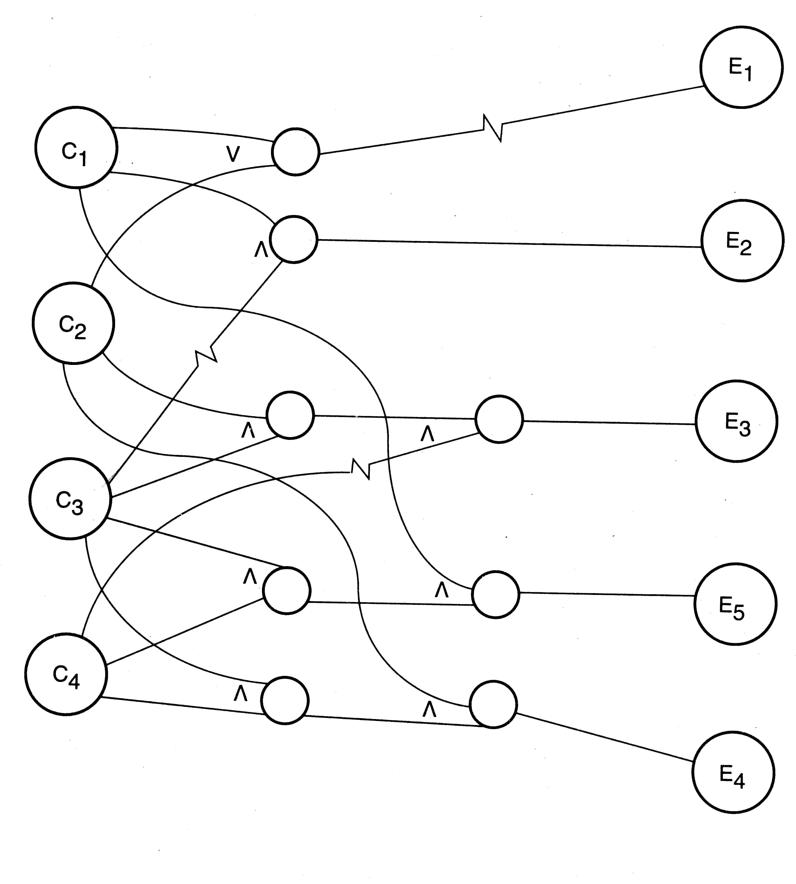
Example…
Testing

Slide 30
Example…
# 1 2 3 4 5
C1 0 1 x x x C2 0 x 1 1 x C3 x 0 1 1 1 C4 x x 0 1 1
E1 1 E2 1 E3 1 E4 1 E5 1
Testing

Slide 31
Pair-wise testing
Often many parameters determine the behavior of a software system
The parameters may be inputs or settings, and take diff values (or diff value ranges)
Many defects involve one condition (single-mode fault), eg. sw not being able to print on some type of printer
  Single mode faults can be detected by testing for different values of diff parms
  If n parms and each can take m values, we can test for one diff value for each parm in each test case
  Total test cases: m
Testing

Slide 32
Pair-wise testing…
All faults are not single-mode and sw may fail at some combinations
  Eg tel billing sw does not compute correct bill for night time calling (one parm) to a particular country (another parm)
  Eg ticketing system fails to book a biz class ticket (a parm) for a child (a parm)
Multi-modal faults can be revealed by testing diff combination of parm values
This is called combinatorial testing
Testing

Slide 33
Pair-wise testing…
Full combinatorial testing not feasible
  For n parms each with m values, total combinations are n^{m}
  For 5 parms, 5 values each (tot: 3125), if one test is 5 mts, tot time > 1 month!
Research suggests that most such faults are revealed by interaction of a pair of values
I.e. most faults tend to be double-mode
For double mode, we need to exercise each pair – called pair-wise testing
Testing

Slide 34
Pair-wise testing…
In pair-wise, all pairs of values have to be exercised in testing
If n parms with m values each, between any 2 parms we have m*m pairs
  1st parm will have m*m with n-1 others
  2nd parm will have m*m pairs with n-2
  3rd parm will have m*m pairs with n-3, etc.
  Total no of pairs are m*m*n*(n-1)/2
Testing

Slide 35
Pair-wise testing…
A test case consists of some setting of the n parameters
Smallest set of test cases when each pair is covered once only
A test case can cover a maximum of (n-1)+(n-2)+…=n(n-1)/2 pairs
In the best case when each pair is covered exactly once, we will have m² different test cases providing the full pair-wise coverage
Testing

Slide 36
Pair-wise testing…
Generating the smallest set of test cases that will provide pair-wise coverage is non-trivial
Efficient algos exist; efficiently generating these test cases can reduce testing effort considerably
  In an example with 13 parms each with 3 values pair-wise coverage can be done with 15 testcases
Pair-wise testing is a practical approach that is widely used in industry
Testing

Slide 37
Pair-wise testing, Example
A sw product for multiple platforms and uses browser as the interface, and is to work with diff OSs
We have these parms and values
  OS (parm A): Windows, Solaris, Linux
  Mem size (B): 128M, 256M, 512M
  Browser (C): IE, Netscape, Mozilla
Total no of pair wise combinations: 27
No of cases can be less
Testing

Slide 38
Pair-wise testing…
Test case | Pairs covered
a1, b1, c1 a1, b2, c2 a1, b3, c3 a2, b1, c2 a2, b2, c3 a2, b3, c1 a3, b1, c3 a3, b2, c1 a3, b3, c2 | (a1,b1) (a1, c1) (b1,c1) (a1,b2) (a1,c2) (b2,c2) (a1,b3) (a1,c3) (b3,c3) (a2,b1) (a2,c2) (b1,c2) (a2,b2) (a2,c3) (b2,c3) (a2,b3) (a2,c1) (b3,c1) (a3,b1) (a3,c3) (b1,c3) (a3,b2) (a3,c1) (b2,c1) (a3,b3) (a3,c2) (b3,c2)
Testing

Slide 39
Special cases
Programs often fail on special cases
These depend on nature of inputs, types of data structures,etc.
No good rules to identify them
One way is to guess when the software might fail and create those test cases
Also called error guessing
Play the sadist & hit where it might hurt
Testing

Slide 40
Error Guessing
Use experience and judgement to guess situations where a programmer might make mistakes
Special cases can arise due to assumptions about inputs, user, operating environment, business, etc.
E.g. A program to count frequency of words
  file empty, file non existent, file only has blanks, contains only one word, all words are same, multiple consecutive blank lines, multiple blanks between words, blanks at the start, words in sorted order, blanks at end of file, etc.
Perhaps the most widely used in practice
Testing

Slide 41
State-based Testing
Some systems are state-less: for same inputs, same behavior is exhibited
Many systems’ behavior depends on the state of the system i.e. for the same input the behavior could be different
I.e. behavior and output depend on the input as well as the system state
System state – represents the cumulative impact of all past inputs
State-based testing is for such systems
Testing

Slide 42
State-based Testing…
A system can be modeled as a state machine
The state space may be too large (is a cross product of all domains of vars)
The state space can be partitioned in a few states, each representing a logical state of interest of the system
State model is generally built from such states
Testing

Slide 43
State-based Testing…
A state model has four components
  States: Logical states representing cumulative impact of past inputs to system
  Transitions: How state changes in response to some events
  Events: Inputs to the system
  Actions: The outputs for the events
Testing

Slide 44
State-based Testing…
State model shows what transitions occur and what actions are performed
Often state model is built from the specifications or requirements
The key challenge is to identify states from the specs/requirements which capture the key properties but is small enough for modeling
Testing

Slide 45
State-based Testing, example…
Consider the student survey example (discussed in Chap 4)
  A system to take survey of students
  Student submits survey and is returned results of the survey so far
  The result may be from the cache (if the database is down) and can be up to 5 surveys old
Testing

Slide 46
State-based Testing, example…
In a series of requests, first 5 may be treated differently
Hence, we have two states: one for req no 1-4 (state 1), and other for 5 (2)
The db can be up or down, and it can go down in any of the two states (3-4)
Once db is down, the system may get into failed state (5), from where it may recover
Testing

Slide 47
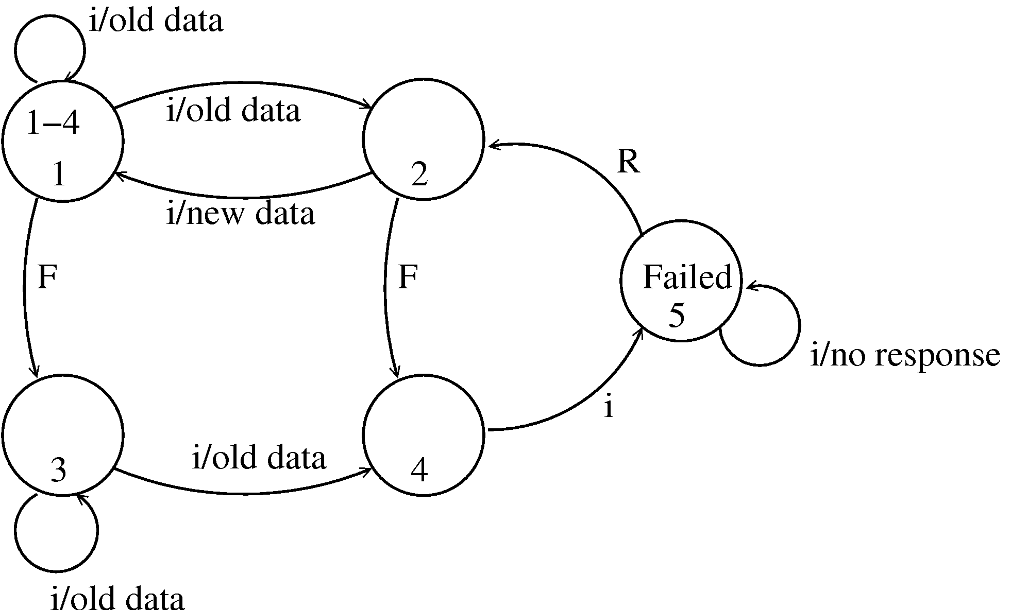
State-based Testing, example…
Testing

Slide 48
State-based Testing…
State model can be created from the specs or the design
For objects, state models are often built during the design process
Test cases can be selected from the state model and later used to test an implementation
Many criteria possible for test cases
Testing

Slide 49
State-based Testing criteria
All transaction coverage (AT): test case set T must ensure that every transition is exercised
All transitions pair coverage (ATP). T must execute all pairs of adjacent transitions (incoming and outgoing transition in a state)
Transition tree coverage (TT). T must execute all simple paths (i.e. a path from start to end or a state it has visited)
Testing

Slide 50
Example, test cases for AT criteria
SNo | Transition | Test case
1 2 3 4 5 6 7 8 | 1 -> 2 1 -> 2 2 -> 1 1 -> 3 3 -> 3 3 -> 4 4 -> 5 5 -> 2 | Req() Req(); req(); req(); req();req(); req() Seq for 2; req() Req(); fail() Req(); fail(); req() Req(); fail(); req(); req(); req();req(); req() Seq for 6; req() Seq for 6; req(); recover()
Testing

Slide 51
State-based testing…
SB testing focuses on testing the states and transitions to/from them
Different system scenarios get tested; some easy to overlook otherwise
State model is often done after design information is available
Hence it is sometimes called grey box testing (as it not pure black box)
Testing

Slide 52
White box testing
Black box testing focuses only on functionality
  What the program does; not how it is implemented
White box testing focuses on implementation
  Aim is to exercise different program structures with the intent of uncovering errors
Is also called structural testing
Various criteria exist for test case design
Test cases have to be selected to satisfy coverage criteria
Testing

Slide 53
Types of structural testing
Control flow based criteria
  looks at the coverage of the control flow graph
Data flow based testing
  looks at the coverage in the definition-use graph
Mutation testing
  looks at various mutants of the program
We will discuss control flow based and data flow based criteria
Testing

Slide 54
Control flow based criteria
Considers the program as control flow graph
  Nodes represent code blocks – i.e. set of statements always executed together
  An edge (i,j) represents a possible transfer of control from i to j
Assume a start node and an end node
A path is a sequence of nodes from start to end
Testing

Slide 55
Statement Coverage Criterion
Criterion: Each statement is executed at least once during testing
I.e. set of paths executed during testing should include all nodes
Limitation: does not require a decision to evaluate to false if no else clause
E.g. : abs (x) : if ( x>=0) x = -x; return(x)
  The set of test cases {x = 0} achieves 100% statement coverage, but error not detected
Guaranteeing 100% coverage not always possible due to possibility of unreachable nodes
Testing

Slide 56
Branch coverage
Criterion: Each edge should be traversed at least once during testing
i.e. each decision must evaluate to both true and false during testing
Branch coverage implies stmt coverage
If multiple conditions in a decision, then all conditions need not be evaluated to T and F
Testing

Slide 57
Control flow based…
There are other criteria too - path coverage, predicate coverage, cyclomatic complexity based, ...
None is sufficient to detect all types of defects (e.g. a program missing some paths cannot be detected)
They provide some quantitative handle on the breadth of testing
More used to evaluate the level of testing rather than selecting test cases
Testing

Slide 58
Data flow-based testing
A def-use graph is constructed from the control flow graph
A stmt in the control flow graph (in which each stmt is a node) can be of these types
  Def: represents definition of a var (i.e. when var is on the lhs)
  C-use: computational use of a var
  P-use: var used in a predicate for control transfer
Testing

Slide 59
Data flow based…
A def-use graph is constructed by associating vars with nodes and edges in the control flow graph
  For a node I, def(i) is the set of vars for which there is a global def in I
  For a node I, C-use(i) is the set of vars for which there is a global c-use in I
  For an edge, p-use(I,j) is set of vars for which there is a p-use for the edge (I,j)
Def clear path from I to j wrt x: if no def of x in the nodes in the path
Testing

Slide 60
Data flow based criteria
all-defs: for every node I, and every x in def(i) there is a def-clear path
  For def of every var, one of its uses (p-use or c-use) must be tested
all-p-uses: all p-uses of all the definitions should be tested
  All p-uses of all the defs must be tested
Some-c-uses, all-c-uses, some-p-uses are some other criteria
Testing

Slide 61
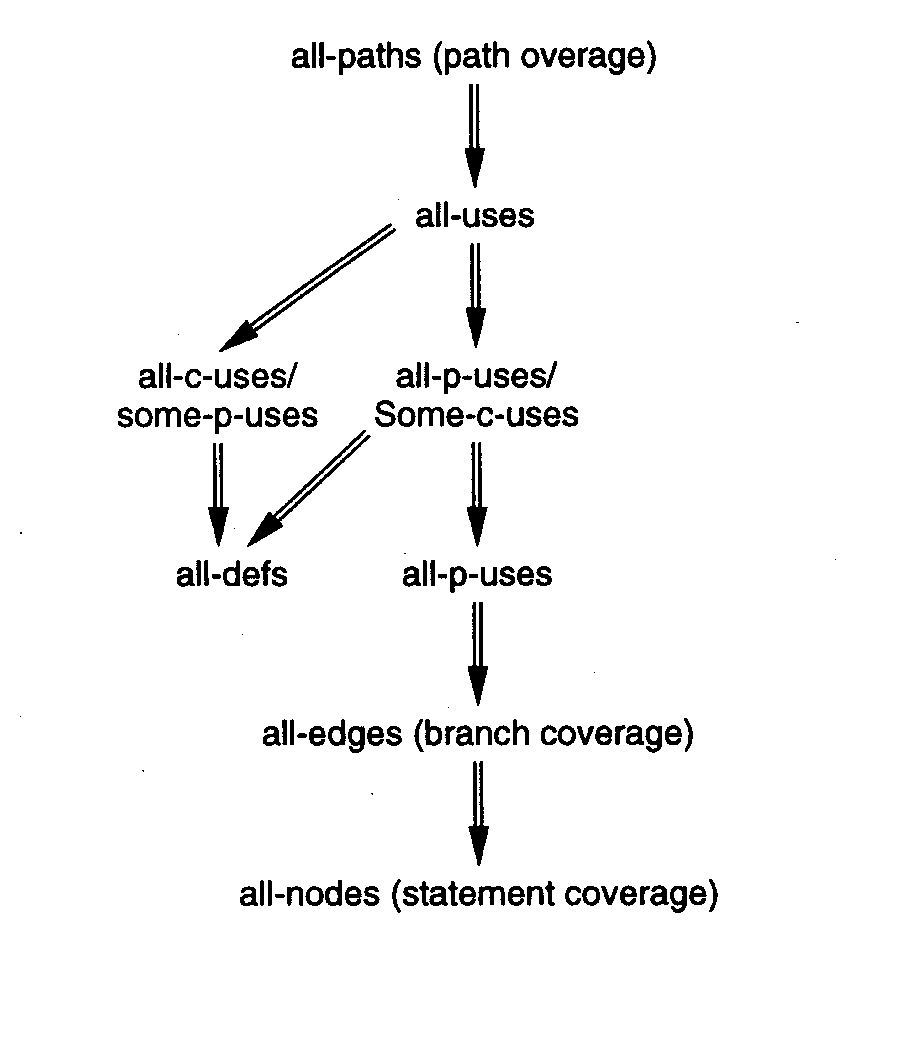
Relationship between diff criteria
Testing

Slide 62
Tool support and test case selection
Two major issues for using these criteria
  How to determine the coverage
  How to select test cases to ensure coverage
For determining coverage - tools are essential
Tools also tell which branches and statements are not executed
Test case selection is mostly manual - test plan is to be augmented based on coverage data
Testing

Slide 63
In a Project
Both functional and structural should be used
Test plans are usually determined using functional methods; during testing, for further rounds, based on the coverage, more test cases can be added
Structural testing is useful at lower levels only; at higher levels ensuring coverage is difficult
Hence, a combination of functional and structural at unit testing
Functional testing (but monitoring of coverage) at higher levels
Testing

Slide 64
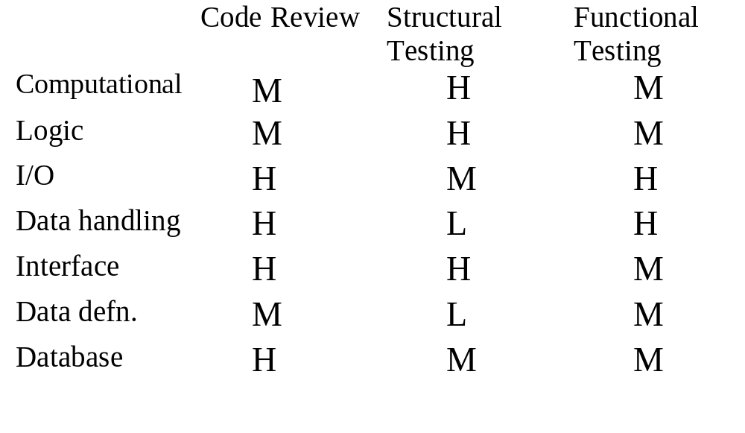
Comparison
Testing

Slide 65
Testing Process
Testing

Slide 66
Testing
Testing only reveals the presence of defects
Does not identify nature and location of defects
Identifying & removing the defect => role of debugging and rework
Preparing test cases, performing testing, defects identification & removal all consume effort
Overall testing becomes very expensive : 30-50% development cost
Testing

Slide 67
Incremental Testing
Goals of testing: detect as many defects as possible, and keep the cost low
Both frequently conflict - increasing testing can catch more defects, but cost also goes up
Incremental testing - add untested parts incrementally to tested portion
For achieving goals, incremental testing essential
  helps catch more defects
  helps in identification and removal
Testing of large systems is always incremental
Testing

Slide 68
Integration and Testing
Incremental testing requires incremental ‘building’ I.e. incrementally integrate parts to form system
Integration & testing are related
During coding, different modules are coded separately
Integration - the order in which they should be tested and combined
Integration is driven mostly by testing needs
Testing

Slide 69
Top-down and Bottom-up
System : Hierarchy of modules
Modules coded separately
Integration can start from bottom or top
Bottom-up requires test drivers
Top-down requires stubs
Both may be used, e.g. for user interfaces top-down; for services bottom-up
Drivers and stubs are code pieces written only for testing
Testing

Slide 70
Levels of Testing
The code contains requirement defects, design defects, and coding defects
Nature of defects is different for different injection stages
One type of testing will be unable to detect the different types of defects
Different levels of testing are used to uncover these defects
Testing

Slide 71
User needs
Acceptance testing
Requirement
specification
System testing
Design
Integration testing
code
Unit testing
Testing

Slide 72
Unit Testing
Different modules tested separately
Focus: defects injected during coding
Essentially a code verification technique, covered in previous chapter
UT is closely associated with coding
Frequently the programmer does UT; coding phase sometimes called “coding and unit testing”
Testing

Slide 73
Integration Testing
Focuses on interaction of modules in a subsystem
Unit tested modules combined to form subsystems
Test cases to “exercise” the interaction of modules in different ways
May be skipped if the system is not too large
Testing

Slide 74
System Testing
Entire software system is tested
Focus: does the software implement the requirements?
Validation exercise for the system with respect to the requirements
Generally the final testing stage before the software is delivered
May be done by independent people
Defects removed by developers
Most time consuming test phase
Testing

Slide 75
Acceptance Testing
Focus: Does the software satisfy user needs?
Generally done by end users/customer in customer environment, with real data
Only after successful AT software is deployed
Any defects found,are removed by developers
Acceptance test plan is based on the acceptance test criteria in the SRS
Testing

Slide 76
Other forms of testing
Performance testing
  tools needed to “measure” performance
Stress testing
  load the system to peak, load generation tools needed
Regression testing
  test that previous functionality works alright
  important when changes are made
  Previous test records are needed for comparisons
  Prioritization of testcases needed when complete test suite cannot be executed for a change
Testing

Slide 77
Test Plan
Testing usually starts with test plan and ends with acceptance testing
Test plan is a general document that defines the scope and approach for testing for the whole project
Inputs are SRS, project plan, design
Test plan identifies what levels of testing will be done, what units will be tested, etc in the project
Testing

Slide 78
Test Plan…
Test plan usually contains
  Test unit specs: what units need to be tested separately
  Features to be tested: these may include functionality, performance, usability,…
  Approach: criteria to be used, when to stop, how to evaluate, etc
  Test deliverables
  Schedule and task allocation
Testing

Slide 79
Test case specifications
Test plan focuses on approach; does not deal with details of testing a unit
Test case specification has to be done separately for each unit
Based on the plan (approach, features,..) test cases are determined for a unit
Expected outcome also needs to be specified for each test case
Testing

Slide 80
Test case specifications…
Together the set of test cases should detect most of the defects
Would like the set of test cases to detect any defects, if it exists
Would also like set of test cases to be small - each test case consumes effort
Determining a reasonable set of test case is the most challenging task of testing
Testing

Slide 81
Test case specifications…
The effectiveness and cost of testing depends on the set of test cases
Q: How to determine if a set of test cases is good? I.e. the set will detect most of the defects, and a smaller set cannot catch these defects
No easy way to determine goodness; usually the set of test cases is reviewed by experts
This requires test cases be specified before testing – a key reason for having test case specs
Test case specs are essentially a table
Testing

Slide 82
Test case specifications…
Seq.No
Condition
to be tested
Expected
result
successful
Test Data
Testing

Slide 83
Test case specifications…
So for each testing, test case specs are developed, reviewed, and executed
Preparing test case specifications is challenging and time consuming
  Test case criteria can be used
  Special cases and scenarios may be used
Once specified, the execution and checking of outputs may be automated through scripts
  Desired if repeated testing is needed
  Regularly done in large projects
Testing

Slide 84
Test case execution and analysis
Executing test cases may require drivers or stubs to be written; some tests can be auto, others manual
  A separate test procedure document may be prepared
Test summary report is often an output – gives a summary of test cases executed, effort, defects found, etc
Monitoring of testing effort is important to ensure that sufficient time is spent
Computer time also is an indicator of how testing is proceeding
Testing

Slide 85
Defect logging and tracking
A large software may have thousands of defects, found by many different people
Often person who fixes (usually the coder) is different from who finds
Due to large scope, reporting and fixing of defects cannot be done informally
Defects found are usually logged in a defect tracking system and then tracked to closure
Defect logging and tracking is one of the best practices in industry
Testing

Slide 86
Defect logging…
A defect in a software project has a life cycle of its own, like
  Found by someone, sometime and logged along with info about it (submitted)
  Job of fixing is assigned; person debugs and then fixes (fixed)
  The manager or the submitter verifies that the defect is indeed fixed (closed)
More elaborate life cycles possible
Testing

Slide 87
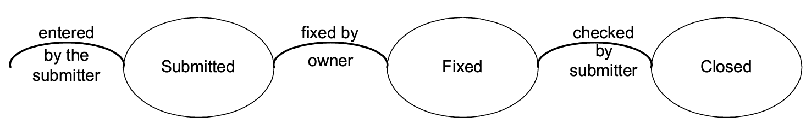
Defect logging…
Testing

Slide 88
Defect logging…
During the life cycle, info about defect is logged at diff stages to help debug as well as analysis
Defects generally categorized into a few types, and type of defects is recorded
  ODC is one classification
  Some std categories: Logic, standards, UI, interface, performance, documentation,..
Testing

Slide 89
Defect logging…
Severity of defects in terms of its impact on sw is also recorded
Severity useful for prioritization of fixing
One categorization
  Critical: Show stopper
  Major: Has a large impact
  Minor: An isolated defect
  Cosmetic: No impact on functionality
Testing

Slide 90
Defect logging and tracking…
Ideally, all defects should be closed
Sometimes, organizations release software with known defects (hopefully of lower severity only)
Organizations have standards for when a product may be released
Defect log may be used to track the trend of how defect arrival and fixing is happening
Testing

Slide 91
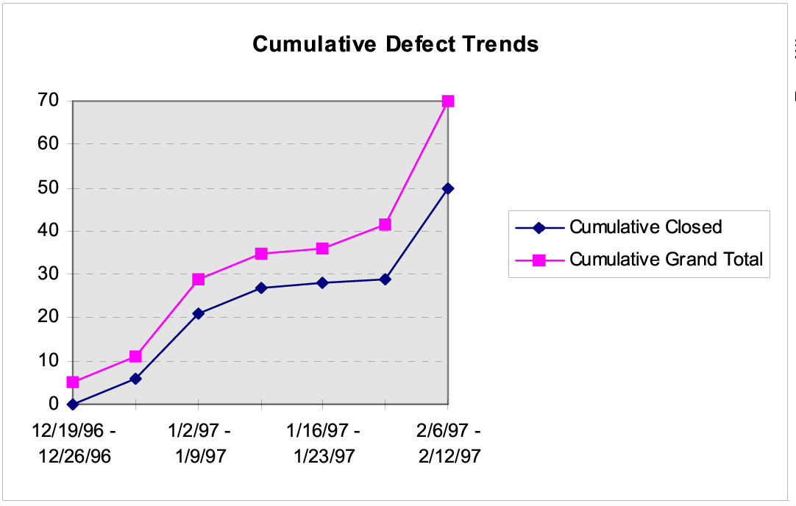
Defect arrival and closure trend
Testing

Slide 92
Defect analysis for prevention
Quality control focuses on removing defects
Goal of defect prevention is to reduce the defect injection rate in future
DP done by analyzing defect log, identifying causes and then remove them
Is an advanced practice, done only in mature organizations
Finally results in actions to be undertaken by individuals to reduce defects in future
Testing

Slide 93
Metrics - Defect removal efficiency
Basic objective of testing is to identify defects present in the programs
Testing is good only if it succeeds in this goal
Defect removal efficiency of a QC activity = % of present defects detected by that QC activity
High DRE of a quality control activity means most defects present at the time will be removed
Testing
Notes:
22

Slide 94
Defect removal efficiency …
DRE for a project can be evaluated only when all defects are know, including delivered defects
Delivered defects are approximated as the number of defects found in some duration after delivery
The injection stage of a defect is the stage in which it was introduced in the software, and detection stage is when it was detected
  These stages are typically logged for defects
With injection and detection stages of all defects, DRE for a QC activity can be computed
Testing
Notes:
25

Slide 95
Defect Removal Efficiency …
DREs of different QC activities are a process property - determined from past data
Past DRE can be used as expected value for this project
Process followed by the project must be improved for better DRE
Testing
Notes:
26

Slide 96
Metrics – Reliability Estimation
High reliability is an important goal being achieved by testing
Reliability is usually quantified as a probability or a failure rate
For a system it can be measured by counting failures over a period of time
Measurement often not possible for software as due to fixes reliability changes, and with one-off, not possible to measure
Testing

Slide 97
Reliability Estimation…
Sw reliability estimation models are used to model the failure followed by fix model of software
Data about failures and their times during the last stages of testing is used by these model
These models then use this data and some statistical techniques to predict the reliability of the software
A simple reliability model is given in the book
Testing

Slide 98
Summary
Testing plays a critical role in removing defects, and in generating confidence
Testing should be such that it catches most defects present, i.e. a high DRE
Multiple levels of testing needed for this
Incremental testing also helps
At each testing, test cases should be specified, reviewed, and then executed
Testing

Slide 99
Summary …
Deciding test cases during planning is the most important aspect of testing
Two approaches – black box and white box
Black box testing - test cases derived from specifications.
  Equivalence class partitioning, boundary value, cause effect graphing, error guessing
White box - aim is to cover code structures
  statement coverage, branch coverage
Testing

Slide 100
Summary…
In a project both used at lower levels
  Test cases initially driven by functional
  Coverage measured, test cases enhanced using coverage data
At higher levels, mostly functional testing done; coverage monitored to evaluate the quality of testing
Defect data is logged, and defects are tracked to closure
The defect data can be used to estimate reliability, DRE
Testing

Slide 101
Software Re-engineering
It is the process of analyzing, designing, and modifying existing software systems to improve their quality, performance, and maintainability.
This can include updating the software to work with new hardware or software platforms, adding new features, or improving the software’s overall design and architecture.
Testing

Slide 102
Objective of Re-engineering
The primary goal of software re-engineering is to improve the quality and maintainability of the software system while minimizing the risks and costs associated with the redevelopment of the system from scratch.
Testing

Slide 103
Objective of Re-engineering
Software re-engineering can be initiated for various reasons, such as:
  To describe a cost-effective option for system evolution.
  To describe the activities involved in the software maintenance process.
  To distinguish between software and data re-engineering and to explain the problems of data re-engineering.
Testing

Slide 104
Process of Software Re-engineering
Planning: The first step is to plan the re-engineering process, which involves identifying the reasons for re-engineering, defining the scope, and establishing the goals and objectives of the process.
Analysis: The next step is to analyze the existing system, including the code, documentation, and other artifacts. This involves identifying the system’s strengths and weaknesses, as well as any issues that need to be addressed.
Design: Based on the analysis, the next step is to design the new or updated software system. This involves identifying the changes that need to be made and developing a plan to implement them.
Testing

Slide 105
Process of Software Re-engineering
Implementation: The next step is to implement the changes by modifying the existing code, adding new features, and updating the documentation and other artifacts.
Testing: Once the changes have been implemented, the software system needs to be tested to ensure that it meets the new requirements and specifications.
Deployment: The final step is to deploy the re-engineered software system and make it available to end-users.
Testing

Slide 106
Reasons for Re-engineering
To improve the software’s performance and scalability
To add new features
To support new platforms
To improve maintainability
To meet new regulations and compliance
Testing

Slide 107
Reasons for Re-engineering
Improving software quality
Updating technology
Enhancing functionality
Resolving issues
Testing

Slide 108
Steps of Re-engineering
Inventory Analysis
Document Reconstruction
Reverse Engineering
Code Reconstruction
Data Reconstruction
Forward Engineering
Testing

Slide 109
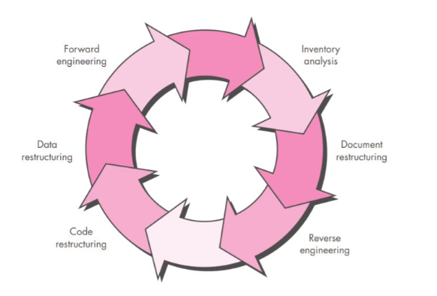
Software Re-engineering
Testing

Slide 110
Reverse Engineering
Code Examination
Documentation Review
System Analysis
Testing

Slide 111
Restructuring
Code Refactoring
Architecture Enhancements
Removal of Obsolete Code
Testing

Slide 112
Forward Engineering
Implementation of Redesigned Components
Introduction of New Features
Testing and Quality Assurance
Testing

Slide 113
Cleanroom Approach
Originally developed by Haran Mills at IBM
First used in late 1980s
It is a software development process intended to produce software with high reliability
Testing

Slide 114
Main Components
Software development is based on formal methods
  Mathematical formalism is included such as model checking, process algebras
  Team review and software tool support is taken for design verification
Testing

Slide 115
Main Components
Incremental implementation under statistical quality control
  Iterative development
  Strict quality checks using pre-established standards
  Failure causes return to design phase
Testing

Slide 116
Main Components
Statistically Sound Testing
  Testing process is carried out as statistical experiment
  Specification is formal
  Reliability of the software is then estimated for certain level of confidence
Testing

Slide 117
References:
https://www.geeksforgeeks.org/software-engineering-re-engineering/
Testing

